Slide 1
Haskell (Functional)

Slide 2
Background and Rationale
Released in 1990
Simon P. Jones, Philip Wadler, Paul Hudak, John Hughes…
No companies involved
Requires brain rewiring
Banks

Slide 3
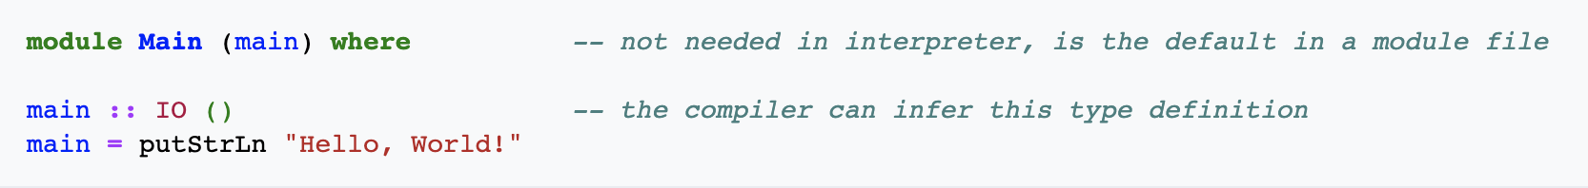
Brief Code Sample

Slide 4
Classification
Functional Language
Diverges from Continuation => NO Expl. Defined Cont. Funct.
More Powerful: Monads
Lazy (vs eager)
Strongly Typed
GHC
Domain-Specific Language, Concurrency, side-effects (i.e. states)
Formalization on language => 80%
Orthogonality

Slide 5
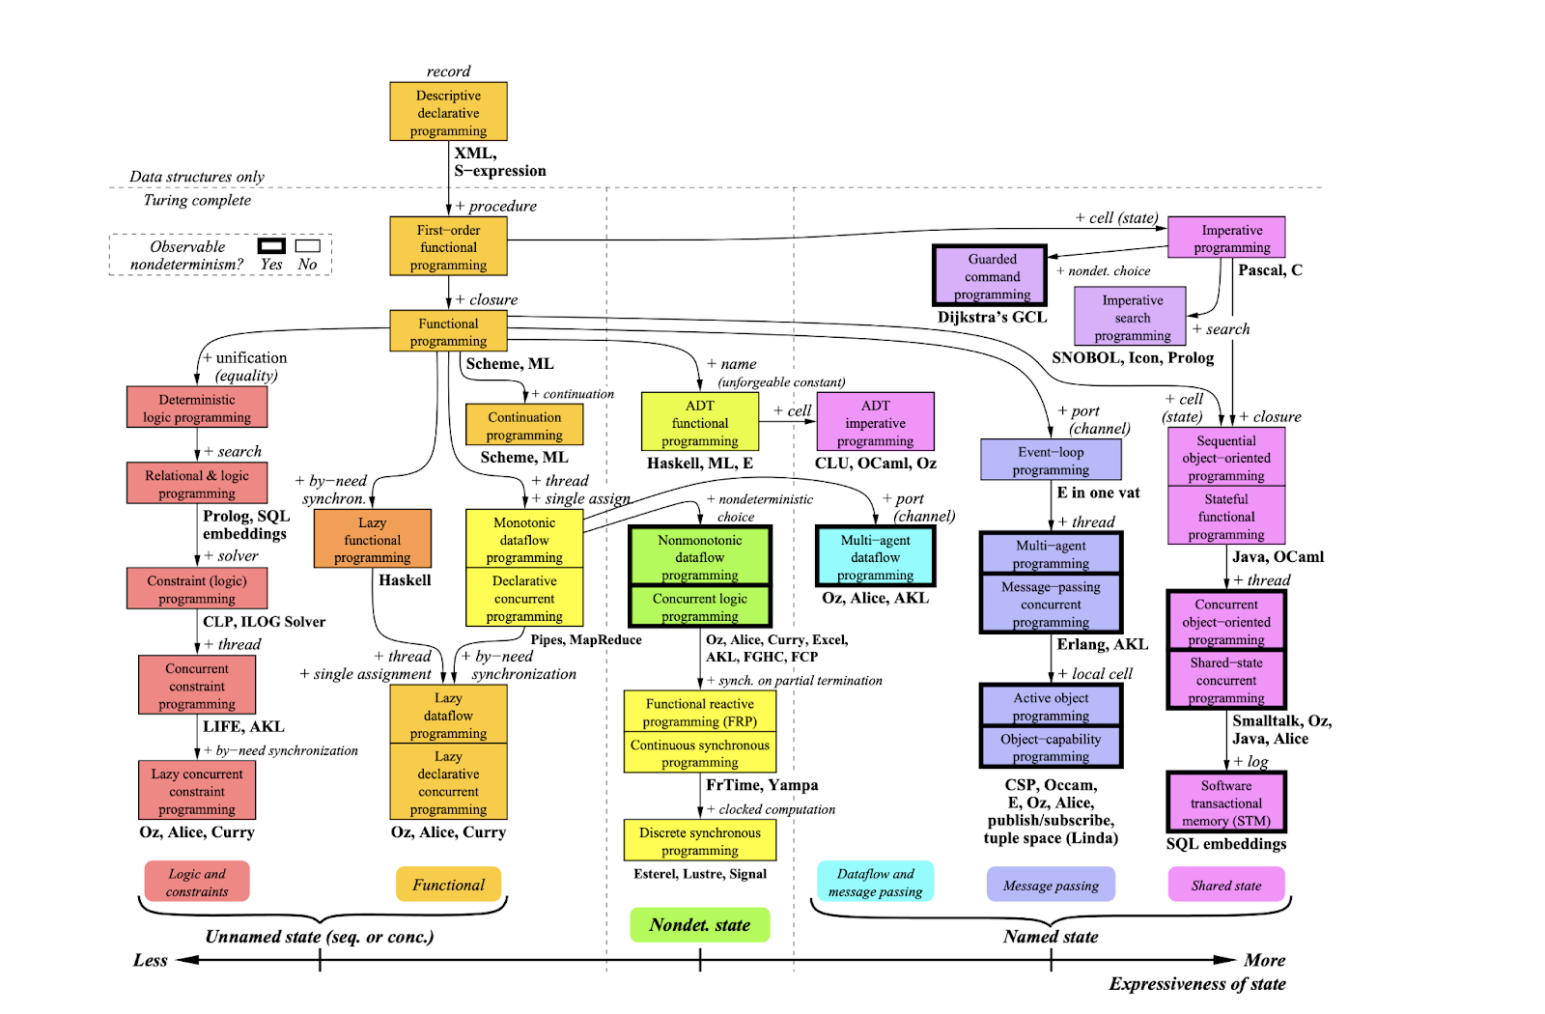

Classification
Patrick von Roy
URL: https://www.info.ucl.ac.be/~pvr/VanRoyChapter.pdf

Slide 6
Evaluation
7/10
Does not stack up well to other FLs
FL features powerful
Pave the way for DSL
Only Lazy Language

Slide 7

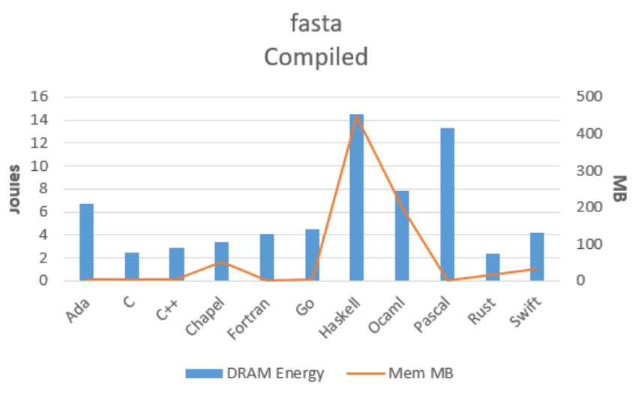
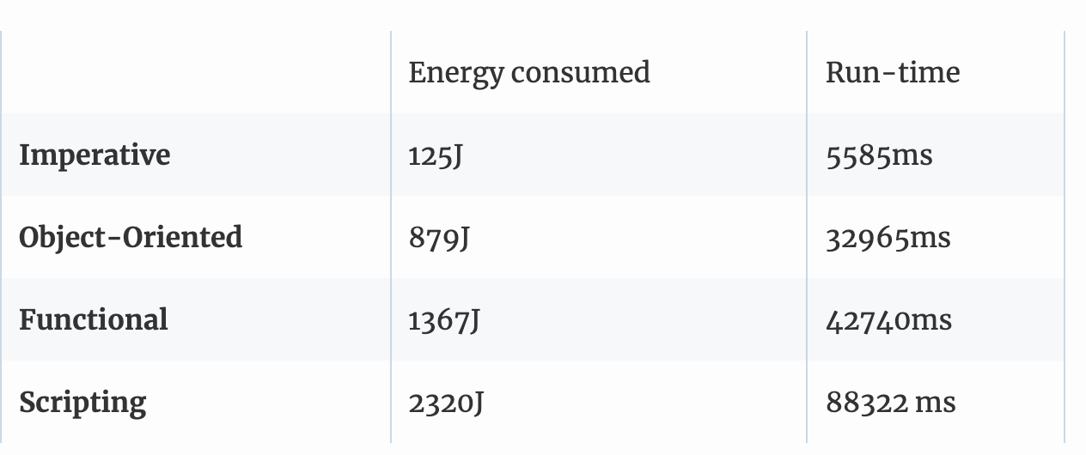
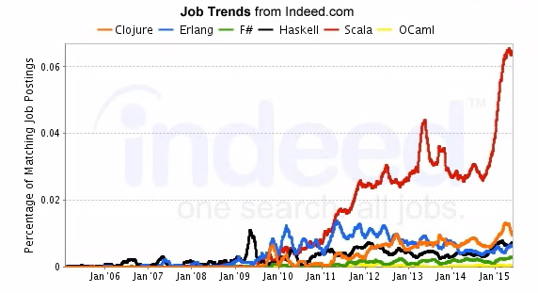
Evaluation

Slide 8
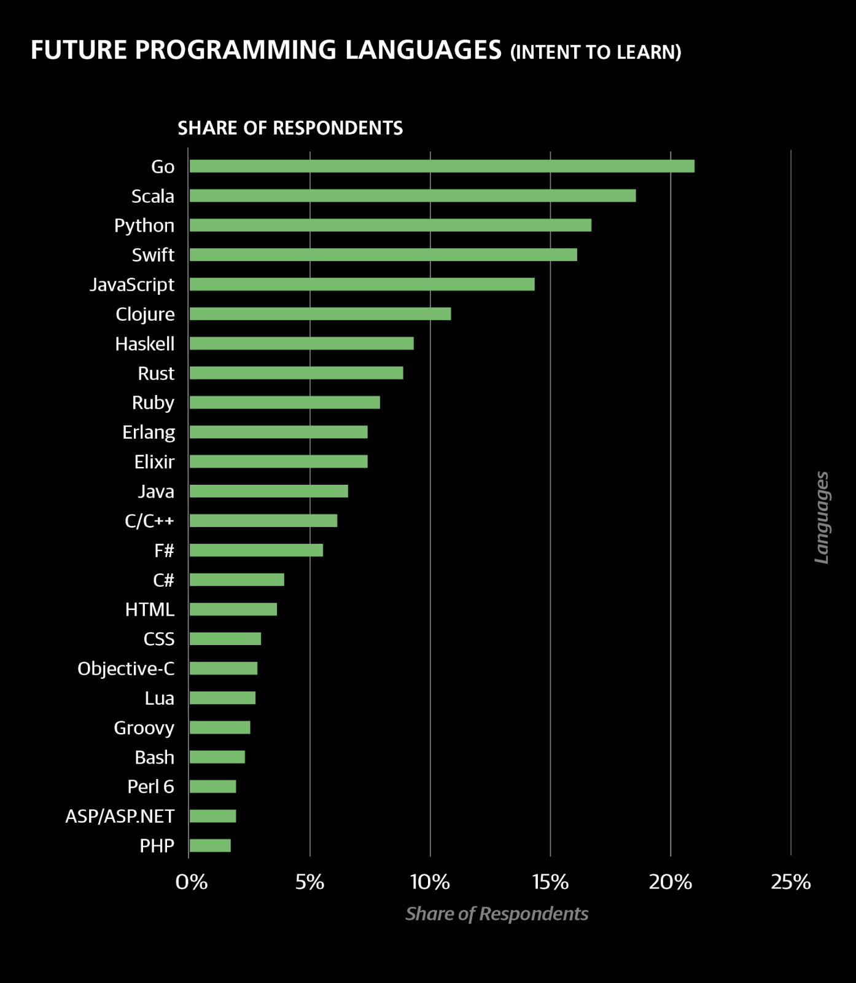
Conclusion

